Slide 1
PHLOX E-Commerce
Team No:10
Submitted By:
LivArpit Sandhu (2210990543)
Aashvi Chawla (2210990019)
Kshitij Raj Shukla (2210990526)
Lokesh Vaid (2210990545)
Submitted To : Dr. Baljit Kaur
Mr.Vikas Patel

Slide 2
Index
Objective
Introduction
Key Features
Technical details
Snapshots
Conclusion
Reference

Slide 3

Objective

Slide 4
“ The objective of creating an e-commerce site using React is to develop a functional and visually appealing online platform for buying goods or services over the internet.”
Here are some specific objectives :
User-Friendly Interface: Design the website with a clean and intuitive layout to make it easy for users to navigate and find products they are interested in purchasing.
Product Listings: Implement a system for displaying products with relevant details such as images, descriptions, prices, and availability.
Shopping Cart: Develop a shopping cart functionality that allows users to add/remove items, view their cart contents, and proceed to checkout.

Slide 5
Search and Filter: Provide search and filtering options to help users easily find products based on their preferences, categories, price range, etc.
Product Reviews and Ratings: Allow users to leave reviews and ratings for products, contributing to trust and transparency in the buying process.
Order Management: Implement functionality for managing orders, including order tracking, status updates, and communication with customers regarding their purchases.
By achieving these objectives, the e-commerce site can effectively facilitate online transactions, enhance customer satisfaction, and contribute to the success of the business.

Slide 6
Key Features
User-friendly Interface: Develop a clean and intuitive interface that facilitates easy navigation, seamless browsing, and efficient search functionality for products.
Responsive Design: Ensure the website is optimized for various devices and screen sizes to provide a consistent user experience across desktops, tablets, and smartphones.
Product Display: Implement visually appealing product displays with high-quality images, detailed descriptions, and clear pricing to engage users and encourage conversions.

Slide 7
Key Features
4. Intuitive Navigation: Implement a user-friendly interface with intuitive navigation, allowing customers to easily find products through well-organized categories, filters, and a robust search functionality.
5. High-Quality Imagery: Showcase products with high-resolution images, enabling users to view items in detail and make informed purchase decisions.

Slide 8

Tools & Technologies
React: Drives dynamic user interfaces with efficient component management.
JavaScript: Adds real-time interactions and content updates for enhanced user experience.
HTML: Provides structural foundation for accessible and searchable content presentation.
CSS: Styles and designs interfaces for consistency and visual appeal.
Tailwind CSS: Streamlines design workflow with customizable utility-first approach.
Responsive Design: Ensures optimal viewing across devices for seamless user experience.

Slide 9
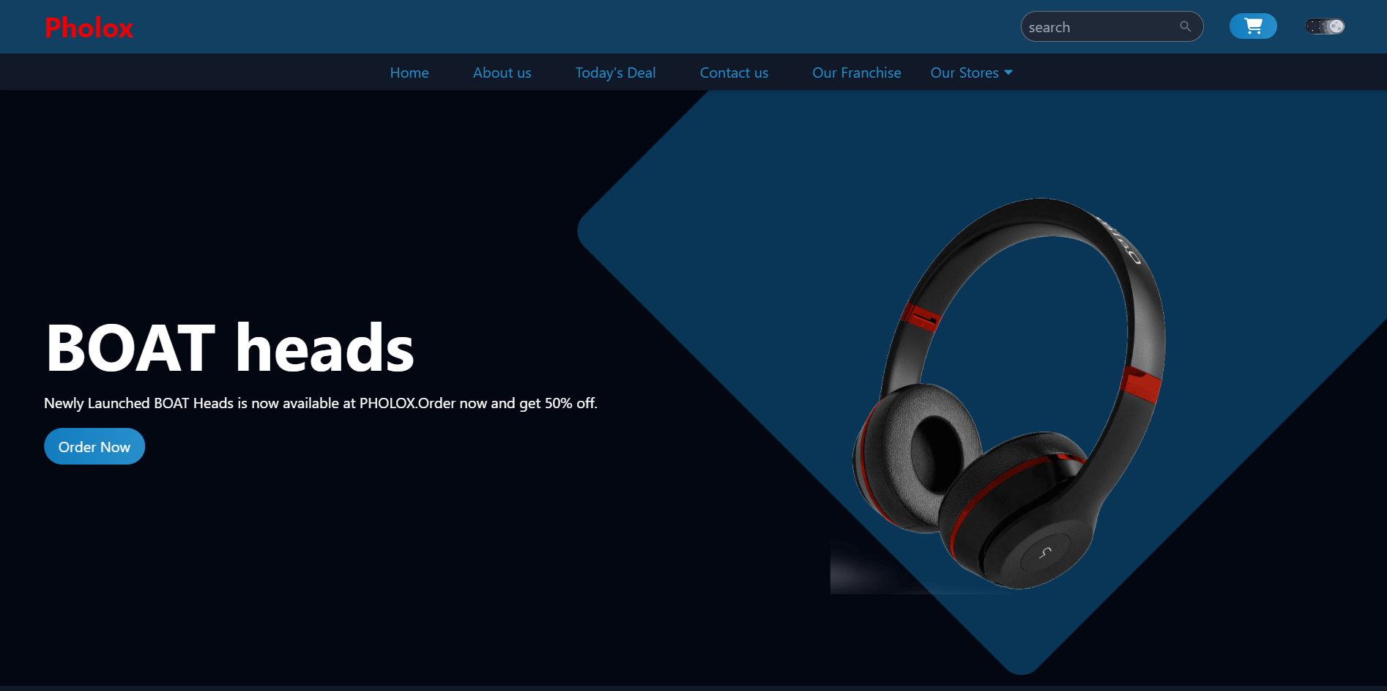
Snapshots

Slide 10
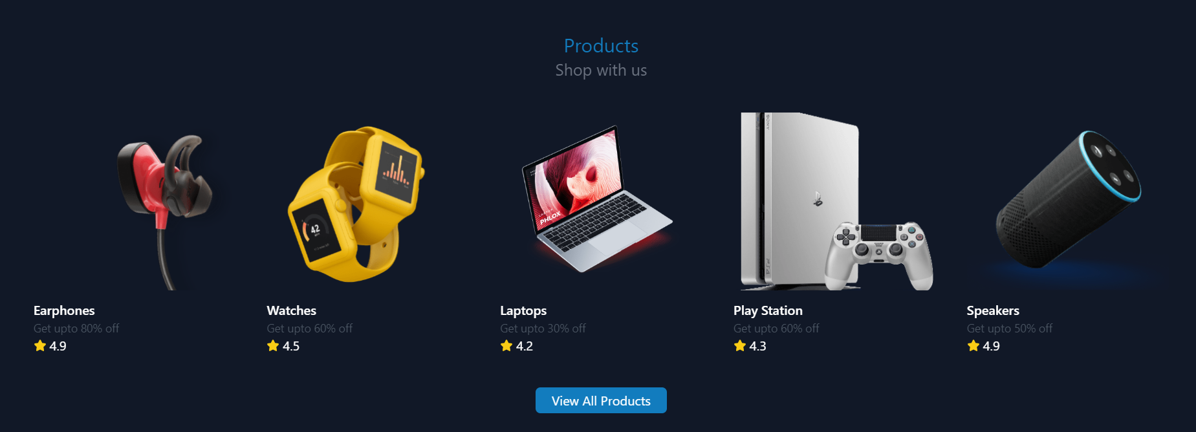
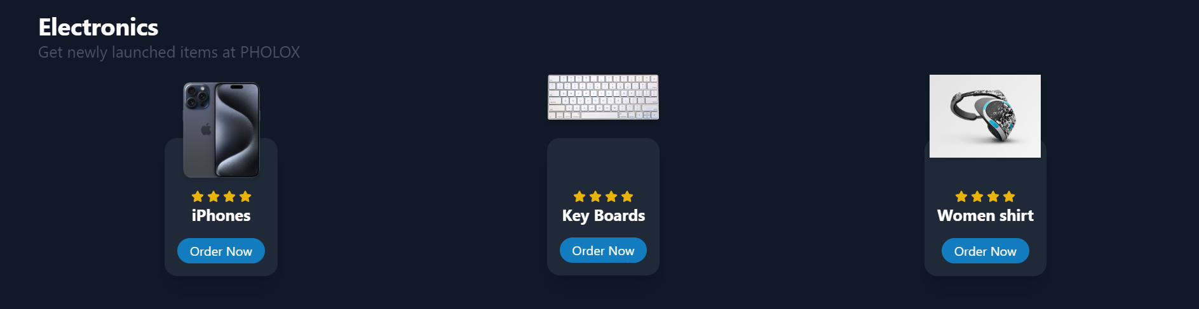
Snapshots

Slide 11
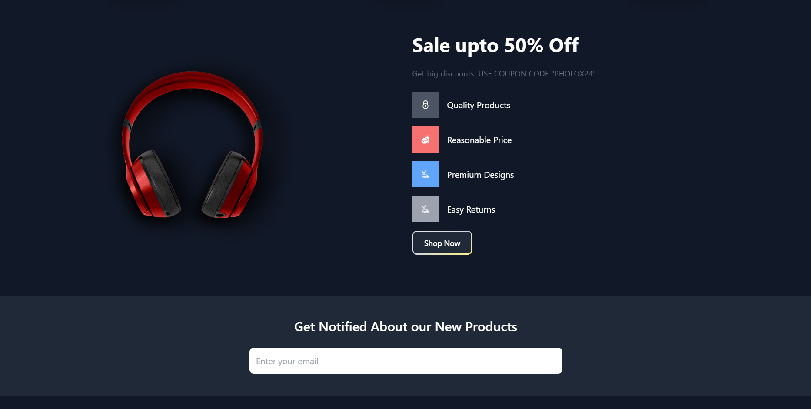
Snapshots

Slide 12
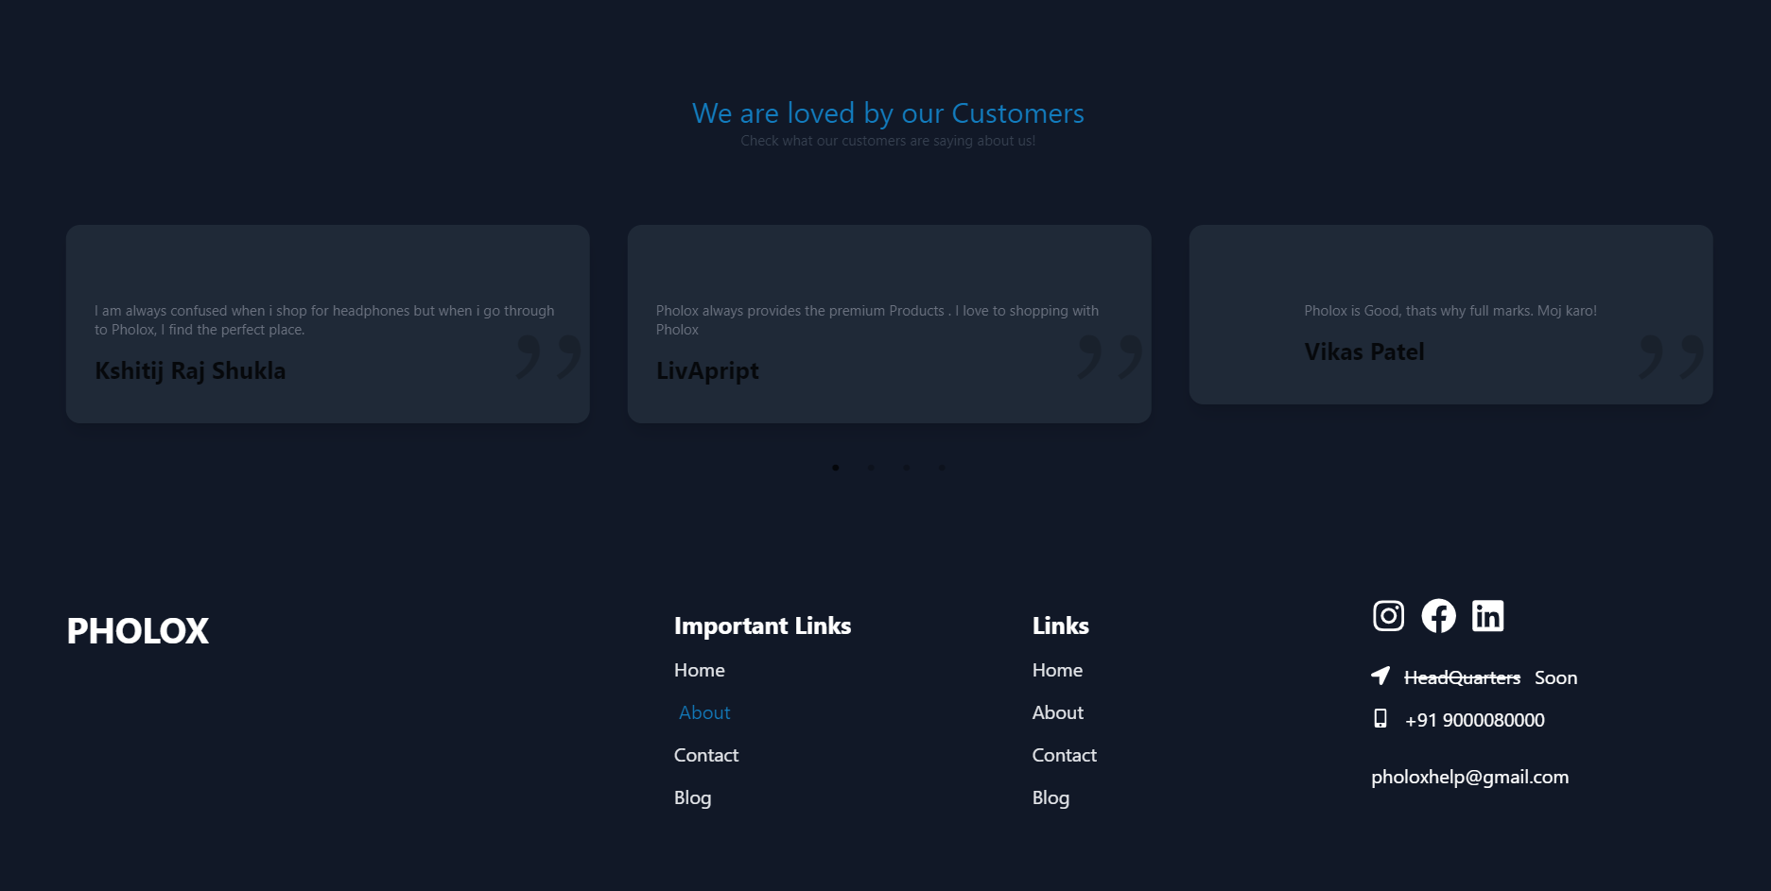
Snapshots

Slide 13
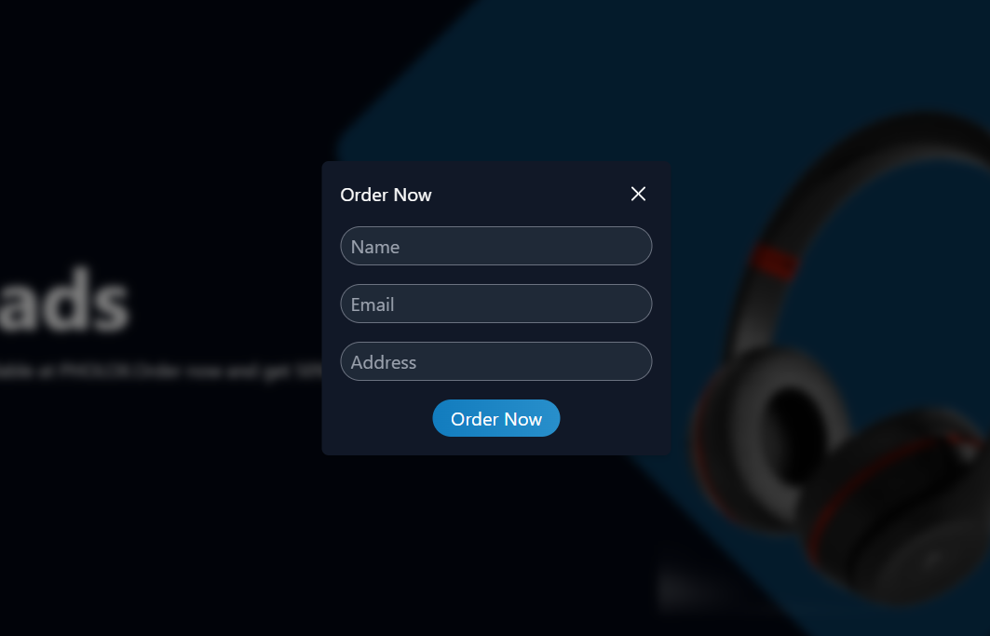
Snapshots

Slide 14

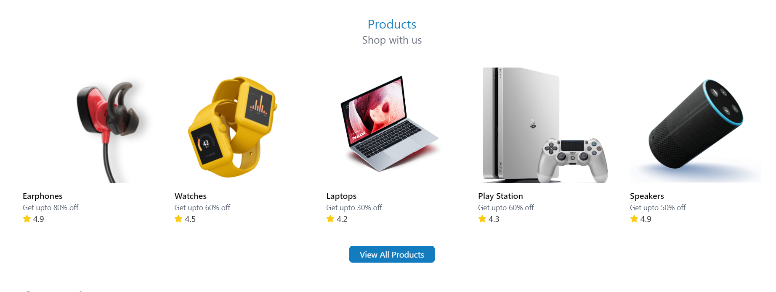

Snapshots

Slide 15
Reference
Tailwind CSS: | https://tailwindcss.com/docs
 | https://tailwindcomponents.com/cheatsheet/
React : | https://react.dev/learn
 | https://reactrouter.com/en/main
 | https://reactjs.org/tutorial/tutorial.html
React icons : | https://react-icons.github.io/react-icons/search/#q=search

Slide 16


